Slide 1
A Framework for Using Drones After a Tornado
INFORMS 2018
SEAN GROGAN, Robert Pellerin, Michel Gamache
École Polytechnique de Montréal
sean.grogan@polymtl.ca
2018

Slide 2
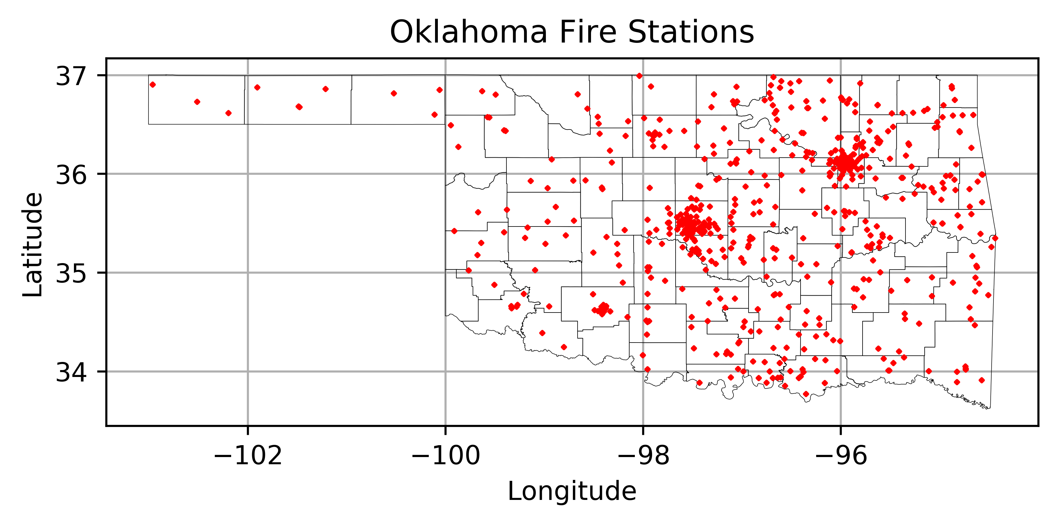
Outline
Introduction and literature overview
Introduction to tornadoes
Problem description and formulation
Framework and application
Concluding remarks

Slide 3
Drones in disaster response
Some organizations and research institutions are adding a new dimension to their search and rescue operations by using UAVs and drones
Proliferation of cell phones provides a detection opportunity
Key study from Beck, et al (2018) where the authors propose a system for assisting in locating people after the Haitian earthquake in 2010
Beck, Zoltan, et al. “Collaborative Online Planning for Automated Victim Search in Disaster Response.” Robotics and Autonomous Systems, vol. 100, 2018, pp. 251–266., doi:10.1016/j.robot.2017.09.014.

Slide 4
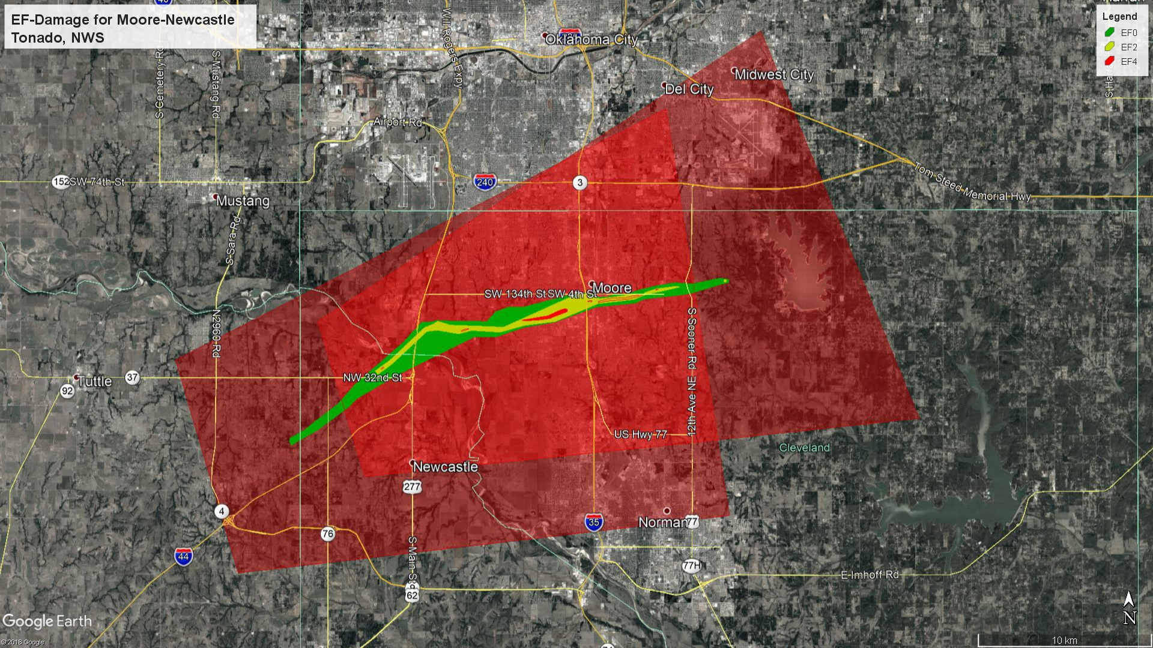
What is a tornado?
A violently rotating column of air in contact with the ground
Usually causes damage to structures near the column of air
The Enhanced Fujita (EF-n) scale is used to asses damage
n can take a value of 1 to 5, inclusive

Slide 5
Predicting a tornado
Organizations like the National Weather Service (NWS) predict the onset of severe weather
Meteorologists can predict these tornado events up to 10 minutes, or more, in advance
A tornado warning is issued when a tornado has been sighted or indicated as being imminent
When a warning is issued, the NWS urges people to take shelter immediately
This is known as a storm based warning (SBW)
Trained spotters will issue local storm reports (LSRs) when a tornado is spotted
Notes:
Some such remote sensing tools are Doppler radar; remote or manned weather stations that track data such as temperature, wind speed, and barometric pressure; and visual observations.
When warning is issued:
POD >70%, 100% for EF4 or greater.
FAR >70%

Slide 6
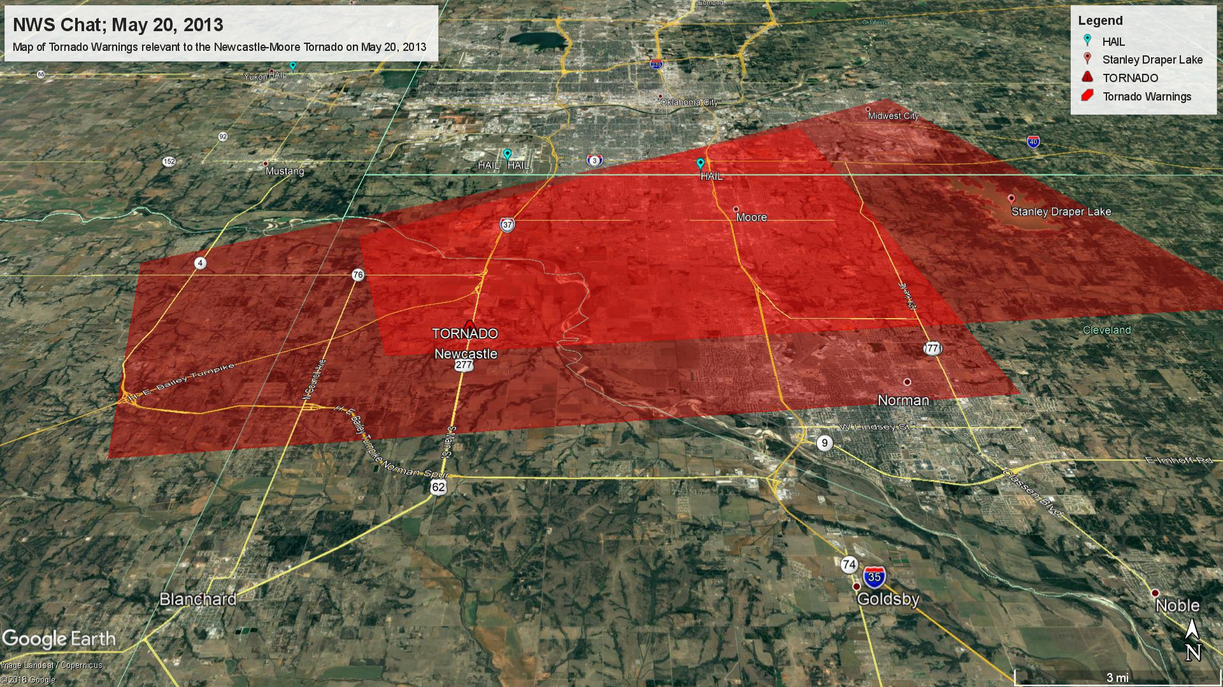
A sample of a storm based warning and a local storm report

Slide 7
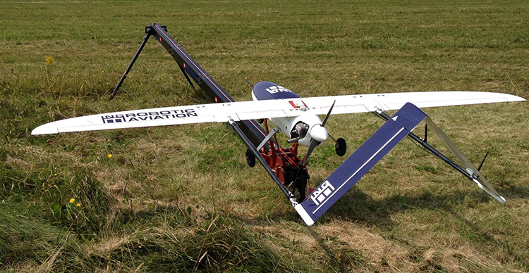
Problem description (1/2)
Using fixed wing drones with wireless sensor and other sensors
Stationed at fire stations throughout the state
Data from:
Weather information from the NWS
Geospatial data from the state of Oklahoma

Slide 8
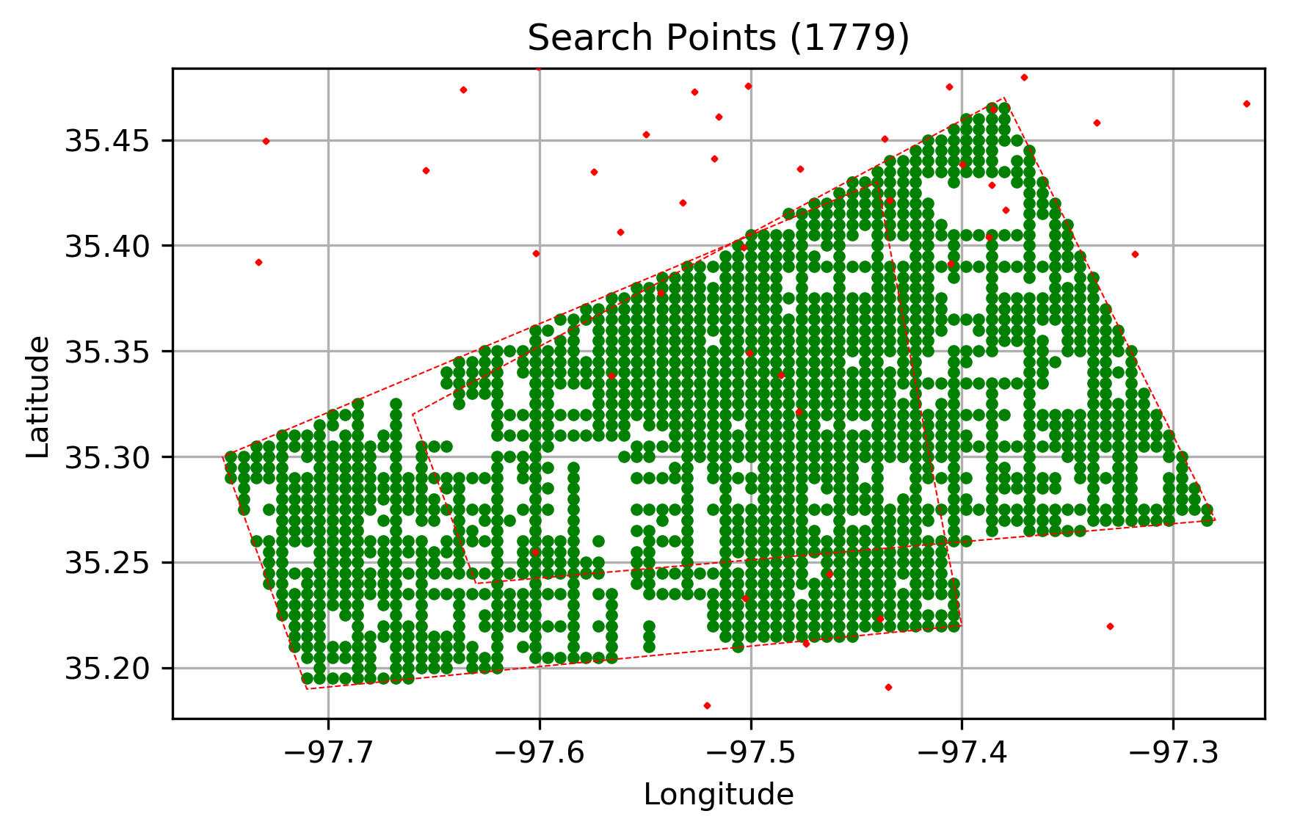
Problem description (2/2)
Formulation envisioned as a distance-constrained vehicle routing problem (DCVRP) with multiple depots
Began with formulation from Kek, et al (2008) and modified to suit the problem here
Overall service time is paramount
Tertiary goals include minimizing the number of drones used and the distance each drone takes in it’s tour

Slide 9
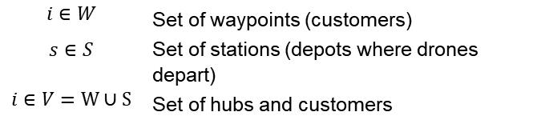

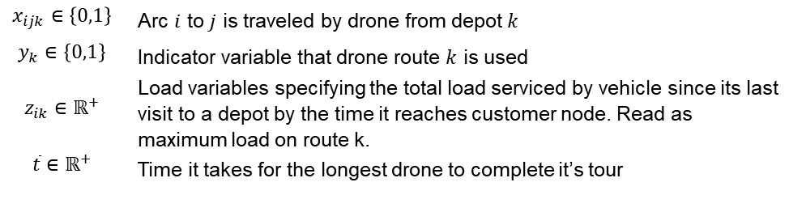
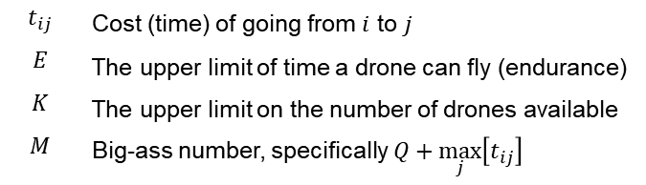
Problem Formulation and Constraints (1/2)
Sets:
Parameters:
$$i∈W$$ | Set of waypoints (customers)
$$s∈S$$ | Set of stations (depots where drones depart)
$$i∈V=W∪S$$ | Set of hubs and customers
$$t_{ij}$$ | Cost (time) of going from $i$ to $j$
$$E$$ | The upper limit of time a drone can fly (endurance)
$$K$$ | The upper limit on the number of drones available
$$M$$ | Big-ass number, specifically $Q+\max_{j}\left[t_{ij}\right]$
Variables:
$$x_{ijk}∈\left\{0,1\right\}$$ | Arc $i$ to $j$ is traveled by drone from depot $k$
$$y_{k}∈\left\{0,1\right\}$$ | Indicator variable that drone route $k$ is used
$$z_{ik}∈ℝ^{+}$$ | Load variables specifying the total load serviced by vehicle since its last visit to a depot by the time it reaches customer node. Read as maximum load on route k.
$$\overline{t}∈ℝ^{+}$$ | Time it takes for the longest drone to complete it’s tour

Slide 10
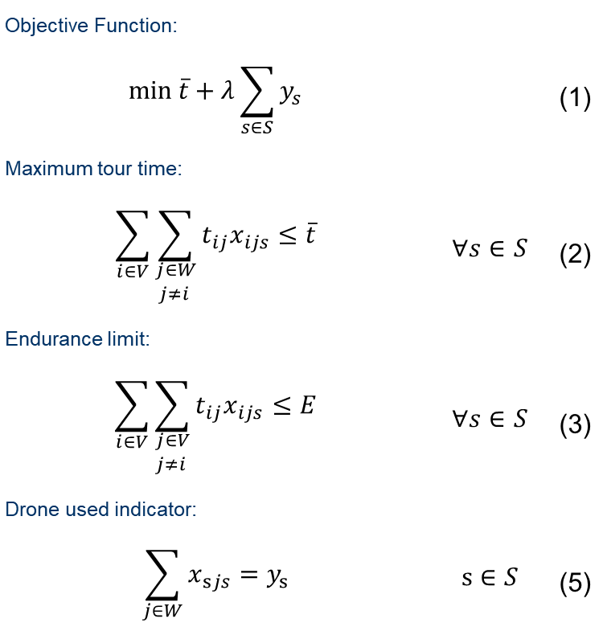
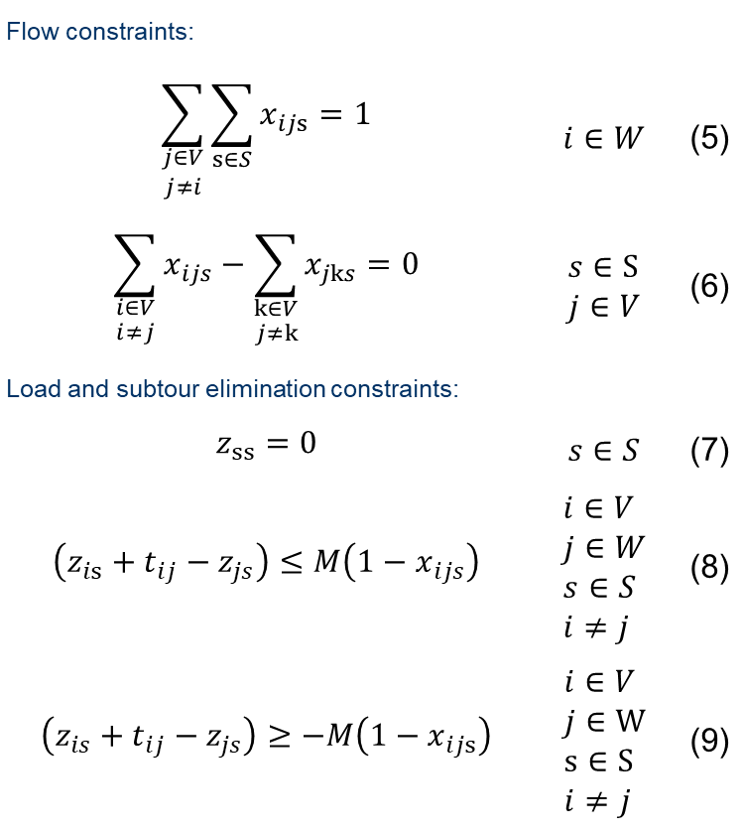
Problem Formulation and Constraints (2/2)
Objective Function:
$$\min{\overline{t}}+λ\sum_{s∈S}{y_{s}}$$ |  | (1)
Maximum tour time:
$$\sum_{i∈V}{\sum_{\begin{aligned}j∈W \\ j≠i \end{aligned}}{t_{ij}x_{ijs}}}≤\overline{t}$$ | $$∀s∈S$$ | (2)
Endurance limit:
$$\sum_{i∈V}{\sum_{\begin{aligned}j∈V \\ j≠i \end{aligned}}{t_{ij}x_{ijs}}}≤E$$ | $$∀s∈S$$ | (3)
Drone used indicator:
$$\sum_{j∈W}{x_{sjs}}=y_{s}$$ | $$s∈S$$ | (5)
Flow constraints:
$$\sum_{\begin{aligned}j∈V \\ j≠i\end{aligned}}{\sum_{s∈S}{x_{ijs}}}=1$$ | $$i∈W$$ | (5)
$$\sum_{\begin{aligned}i∈V \\ i≠j\end{aligned}}{x_{ijs}}−\sum_{\begin{aligned}k∈V \\ j≠k\end{aligned}}{x_{jks}}=0$$ | $$s∈S \\ j∈V$$ | (6)
Load and subtour elimination constraints:
$$z_{ss}=0$$ | $$s∈S$$ | (7)
$$\left(z_{is}+t_{ij}−z_{js}\right)≤M\left(1−x_{ijs}\right)$$ | $$i∈V \\ j∈W \\ s∈S \\ i≠j$$ | (8)
$$\left(z_{is}+t_{ij}−z_{js}\right)≥−M\left(1−x_{ijs}\right)$$ | $$i∈V \\ j∈W \\ s∈S \\ i≠j$$ | (9)
Notes:
(8) And (9) are a linear combo of $\sum_{i∈V}{\sum_{s∈S}{x_{ijs}\left(z_{is}−z_{js}+d_{j}\right)}}=0 ∀j∈W$

Slide 11
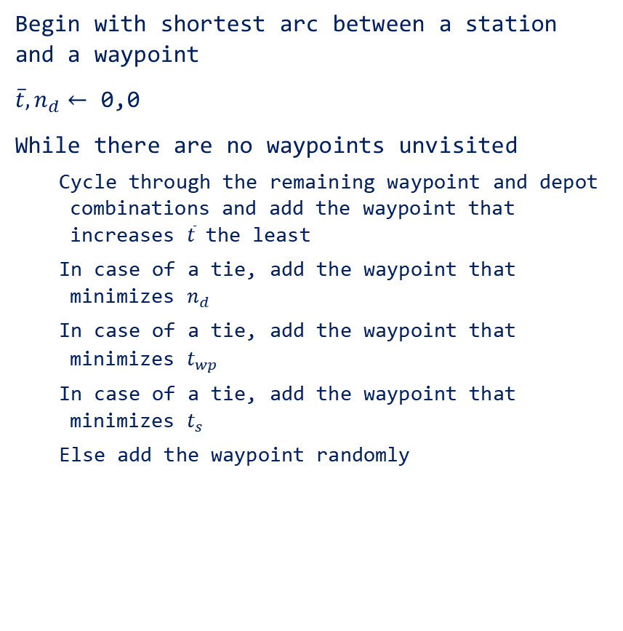
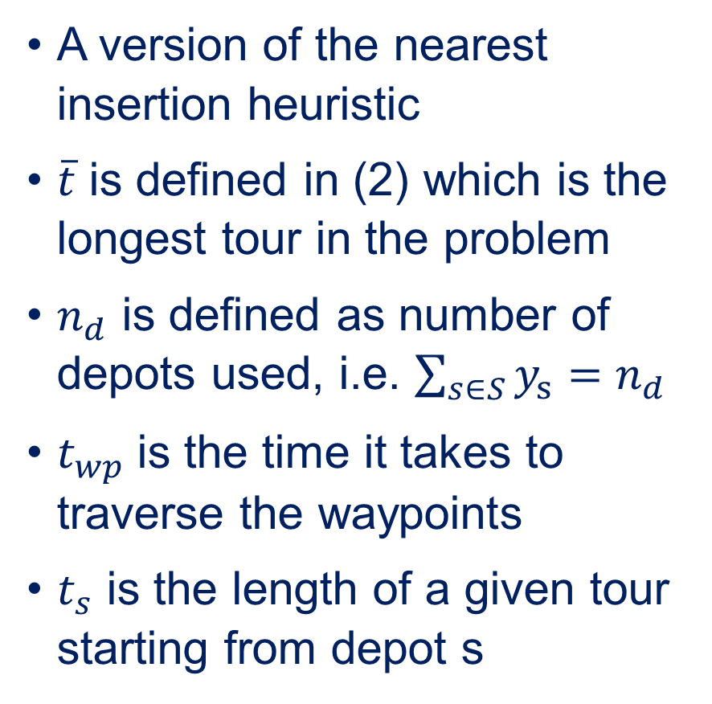
Proposed heuristic
A version of the nearest insertion heuristic
$\overline{t}$ is defined in (2) which is the longest tour in the problem
$n_{d}$ is defined as number of depots used, i.e. $\sum_{s∈S}{y_{s}}=n_{d}$
$t_{wp}$ is the time it takes to traverse the waypoints
$t_{s}$ is the length of a given tour starting from depot s
Begin with shortest arc between a station and a waypoint
$\overline{t}, n_{d}←$ 0,0
While there are no waypoints unvisited
Cycle through the remaining waypoint and depot combinations and add the waypoint that increases $\overline{t}$ the least
In case of a tie, add the waypoint that minimizes $n_{d}$
In case of a tie, add the waypoint that minimizes $t_{wp}$
In case of a tie, add the waypoint that minimizes $t_{s}$
Else add the waypoint randomly

Slide 12
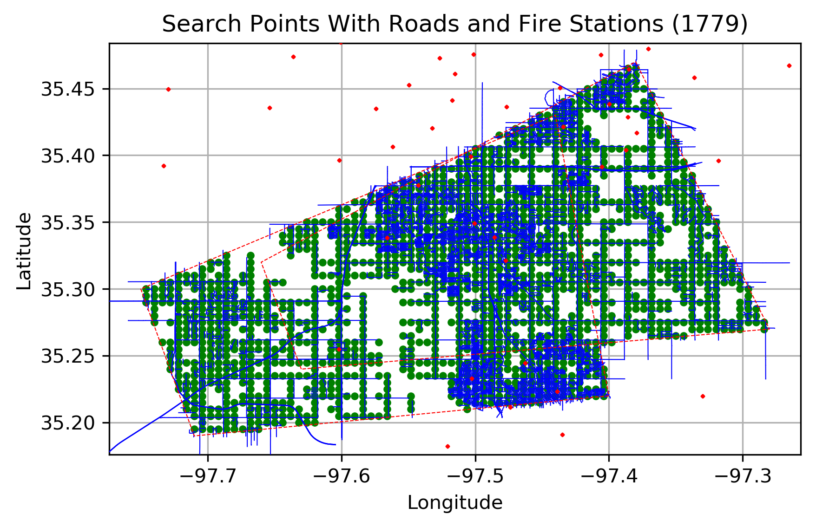
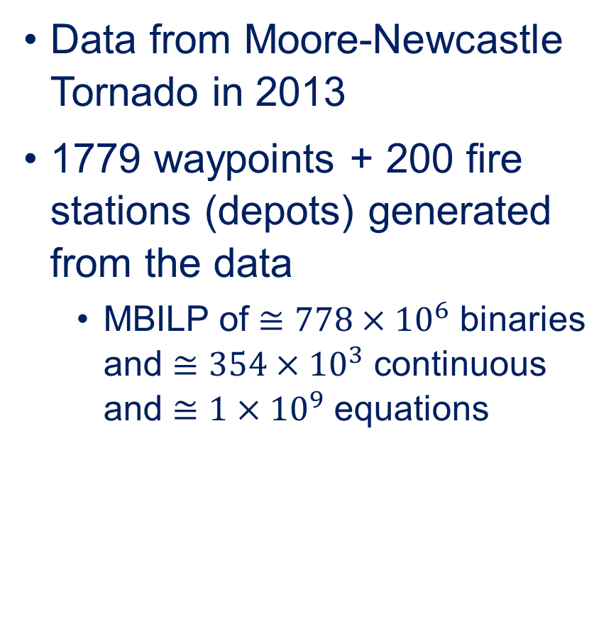
Test case
Data from Moore-Newcastle Tornado in 2013
1779 waypoints + 200 fire stations (depots) generated from the data
MBILP of $≅778×{10}^{6}$ binaries and $≅354×{10}^{3}$ continuous and $≅1×{10}^{9}$ equations

Slide 13
Test case

Slide 14
Test case

Slide 15
Executing the test case
Executed on an AMD A7-7600 APU processor with 16GB of ram
Loading and processing data takes approximately 120 seconds
Two heuristics tested: cluster-first route second and nearest neighbor
Clustering was parallelized
 | t_bar (hr) | Time (s) | Launches
Clustering | 7.9 | 10 | 25
Nearest | 3.1 | 363 | 21

Slide 16
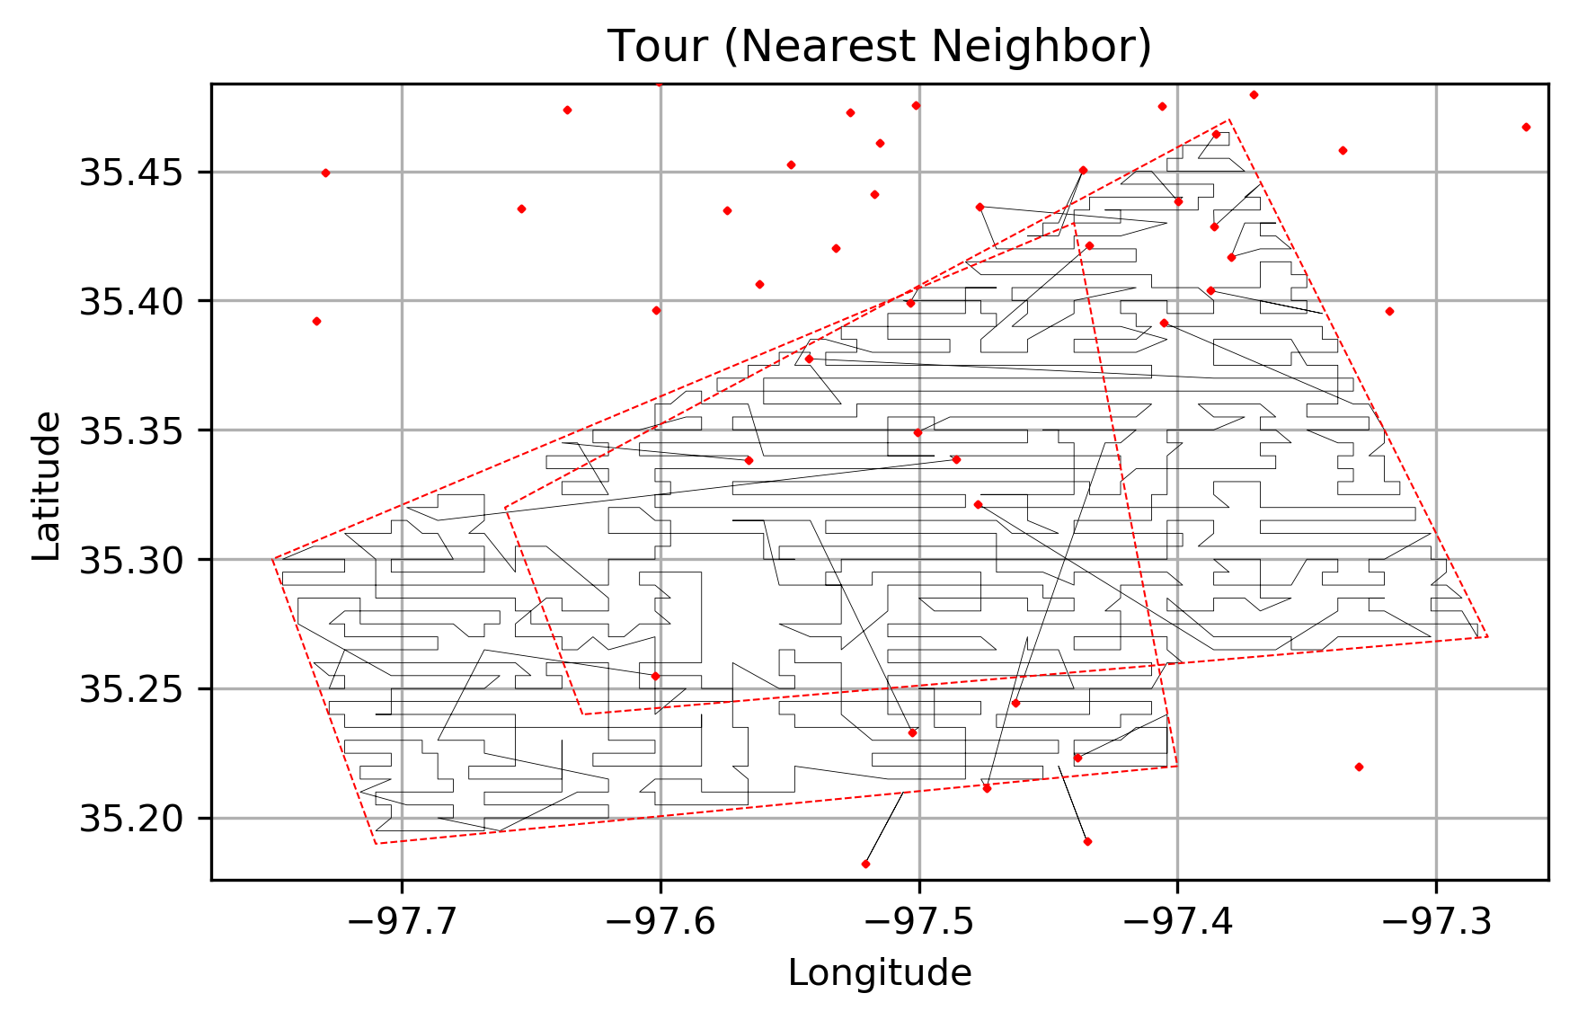
 | t_bar (hr) | Time (s) | Launches
Nearest | 3.1 | 363 | 21

Slide 17
Conclusions and future steps
Finish the (meta)heuristic.
While we task the UAVs to search the entire area; often times, the damage associated with the tornado is a small part of this initial search area.
While the objective of this paper was to scan the entire search area in as short amount of time - in practice the objective should be to find the damaged area as quickly as possible.
In an operational sense, once some damage is uncovered, the drone can re-allocate itself to prioritize adjacent areas as the best indicator of a damaged structure is another damaged structure.
In practice, manned aircraft must return to base, but the UAVs could potentially land away from base and be picked up by a staff member.

Slide 18

Thank You
Contact:
Sean Grogan sean.grogan@polymtl.ca 514-207-0075 802-448-0772

